Slide 1
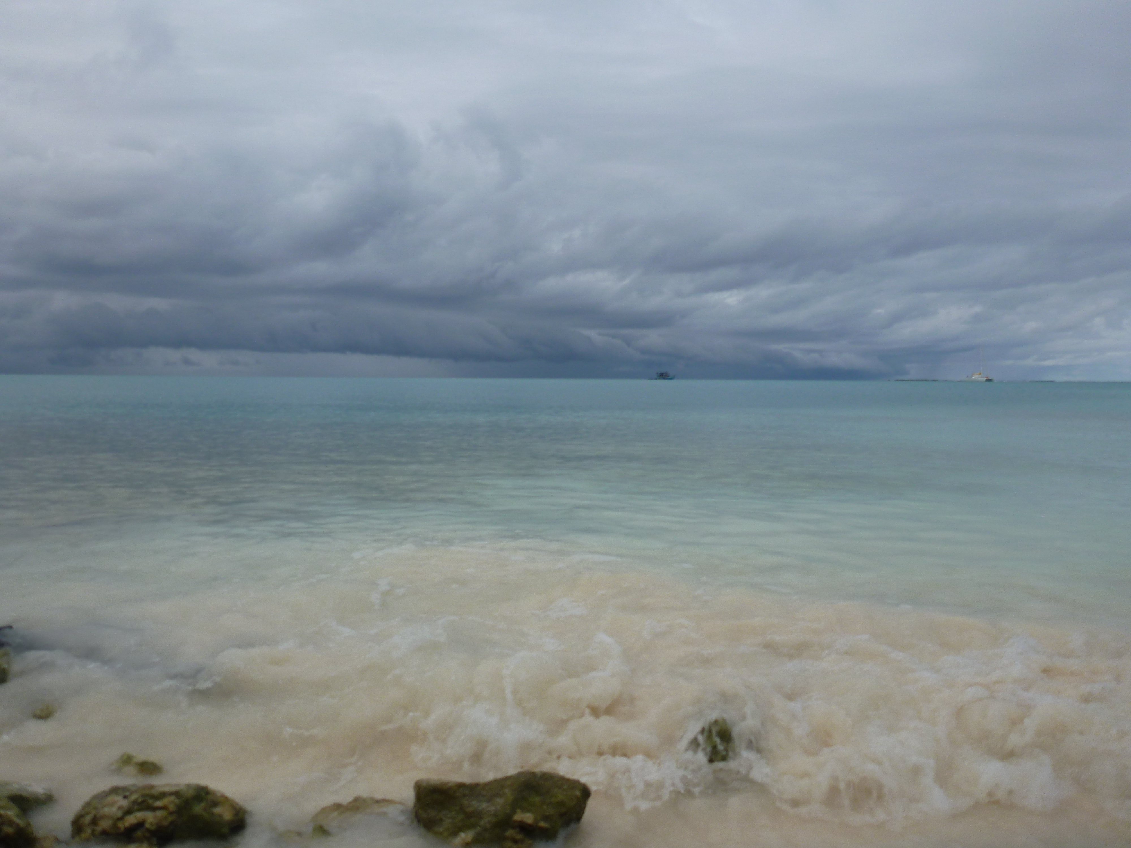
Effects of Large-Scale Waves and Humidity on Convective Depth
Scott W. Powell and Robert A. Houze, Jr.
University of Washington, Seattle, WA
March 6, 2013
MJO Field Data and Science Workshop, Kohala Coast, HI
Breakout Session 4B
This work was supported by NSF grant AGS-1059611 and DOE grants DE-SC0001164 / ER-64752 and DE-SC0008452.

Slide 3
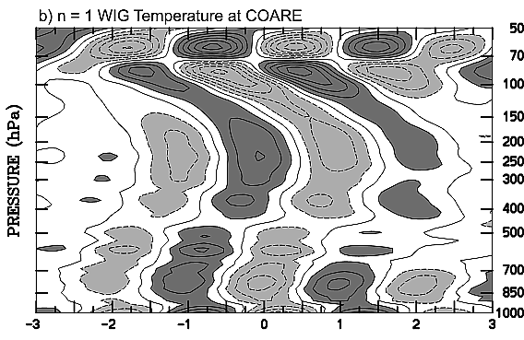
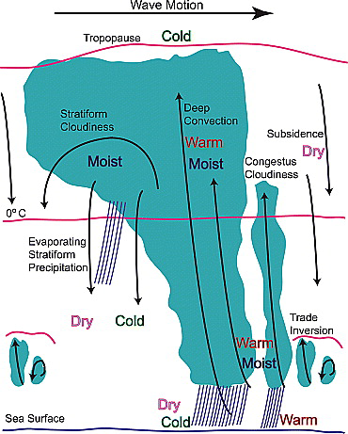
Kiladis et al. (2005)
Zuluaga and Houze (2013)
Kiladis et al. (2009)
Powell and Houze (2013)
CE1
CE2
23.4 m s⁻¹
CE3
10.7 m s⁻¹

